Slide 1


LRC’s Spring ‘24
Air Force ROTC Detachment 842
The University of Texas at San Antonio
C/1st Lt Dylan Fresquez
14 Feb 23

Slide 2


Overview
Timeline
POC Timeline
Teams
Equipment
Helmets
Groups
Locations
Required Items
UOD
Safety/Execution
Air Force ROTC Detachment 842 • We Build Exceptional Officers • The University of Texas at San Antonio

Slide 3
Timeline
Cadets will arrive at Brackenridge lot NLT 0700
Cadets will depart to Lackland AFB at 0730
Cadets will arrive at Lackland AFB at 0800
LRCs will begin at 0830
Breaks will be be administered hourly
LRCs will end at 1200
Cadets will depart to UTSA at 1210
Air Force ROTC Detachment 842 • We Build Exceptional Officers • The University of Texas at San Antonio

Slide 4
POC Timeline
POC will arrive at Brackenridge lot NLT 0630
Non-OPS will depart to Lackland AFB at 0700
All Non-OPS will set up LRC materials
GMC Arrive to Lackland AFB at 0800
Begin Safety Briefing at 0820
Evaluators will get their group and transition to their station at 0830
Begin first phase of LRC Rotations at 0840
End LRC and cleanup area at 1200
Air Force ROTC Detachment 842 • We Build Exceptional Officers • The University of Texas at San Antonio

Slide 5
Teams
Accountability Team
C/Anderson (Lead)
SQ/CC & FLT/CC will report accountability to team lead before and after transiting between Lackland and UTSA
Evaluation Team
C/Garza (Lead)
Evaluators will man a single station and evaluate rotating groups each time
Assembly Team
C/Finley (Lead)
Responsible for helping POC get materials for each Scenario being used, and set up any tables/canopies.
Safety Team
C/Burns (Lead)
Responsible for going around the area making sure everyone is feeling well, and making sure everyone is hydrated
Air Force ROTC Detachment 842 • We Build Exceptional Officers • The University of Texas at San Antonio

Slide 6
Equipment
Detachment Van can Transport the following items
2-3 Gallon Water Jugs
2-3 Tables (the shed did have one table inside)
Helmets
1-2 Canopies for shade
Air Force ROTC Detachment 842 • We Build Exceptional Officers • The University of Texas at San Antonio

Slide 7
Helmets
GMC size 128
82 Helmets from Cadet Wing
17 Helmets from LRS
≈ 30 Helmets to be rented
Rec on Randolph/Lackland
Air Force ROTC Detachment 842 • We Build Exceptional Officers • The University of Texas at San Antonio

Slide 8
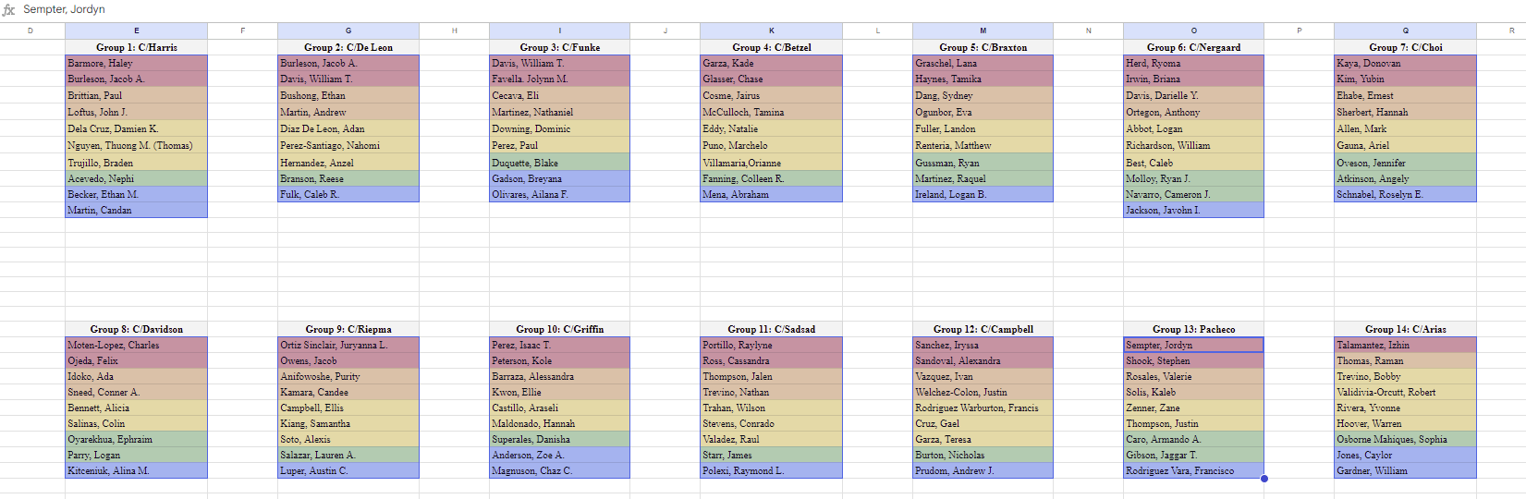
Groups
14 Groups of 9-10 Cadets
Air Force ROTC Detachment 842 • We Build Exceptional Officers • The University of Texas at San Antonio

Slide 9
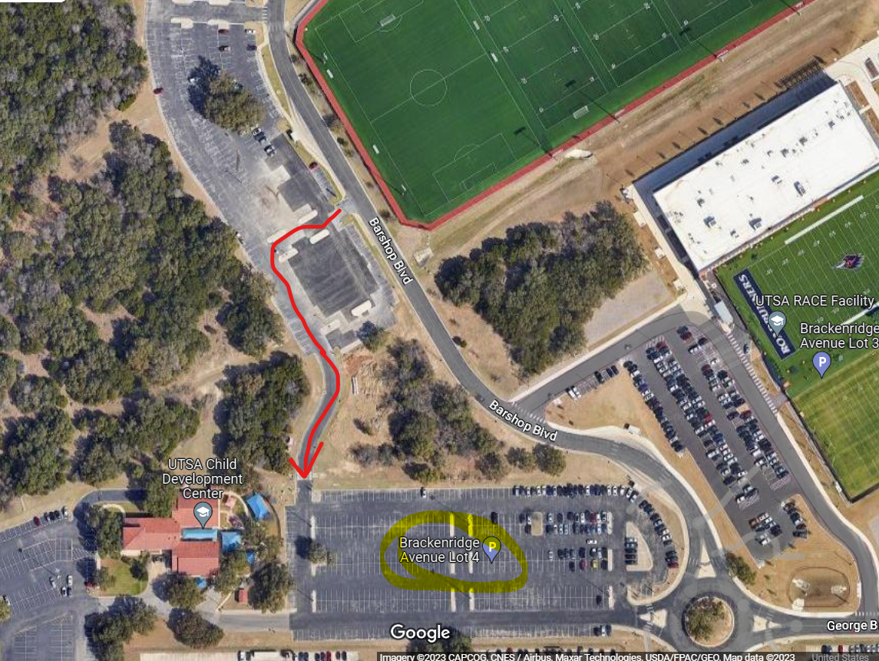
Locations
Cadets will arrive at Brackenridge lot 4. at 0700.
POC Flight Commanders will take accountability and check required items
GMC will separate into carpool groups and depart to Lackland AFB at 0730
Air Force ROTC Detachment 842 • We Build Exceptional Officers • The University of Texas at San Antonio

Slide 10
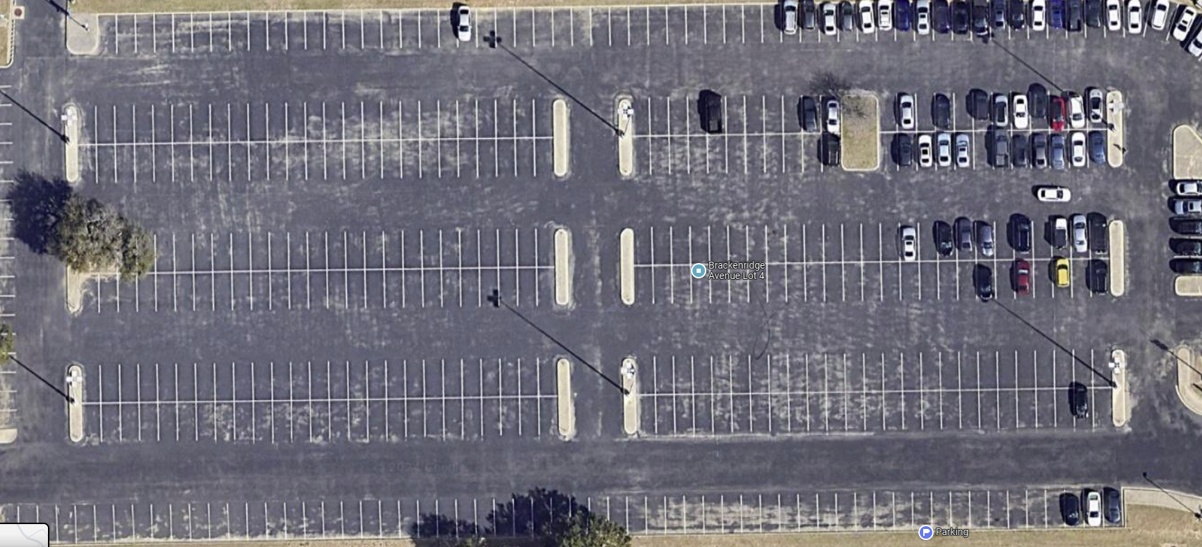
Locations
Delta
Echo
Foxtrot
Golf
Hotel
POC
Air Force ROTC Detachment 842 • We Build Exceptional Officers • The University of Texas at San Antonio

Slide 11
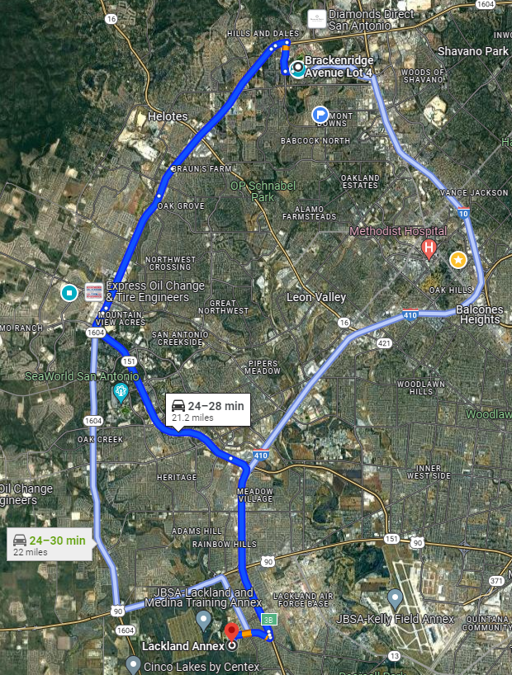
Locations
Location of LRC’s
29°22'10.0"N 98°39'13.7"W
Go through the Chapman Gate
Take a Left at the small road right before the Fire Station
POC will Guide
Air Force ROTC Detachment 842 • We Build Exceptional Officers • The University of Texas at San Antonio

Slide 12
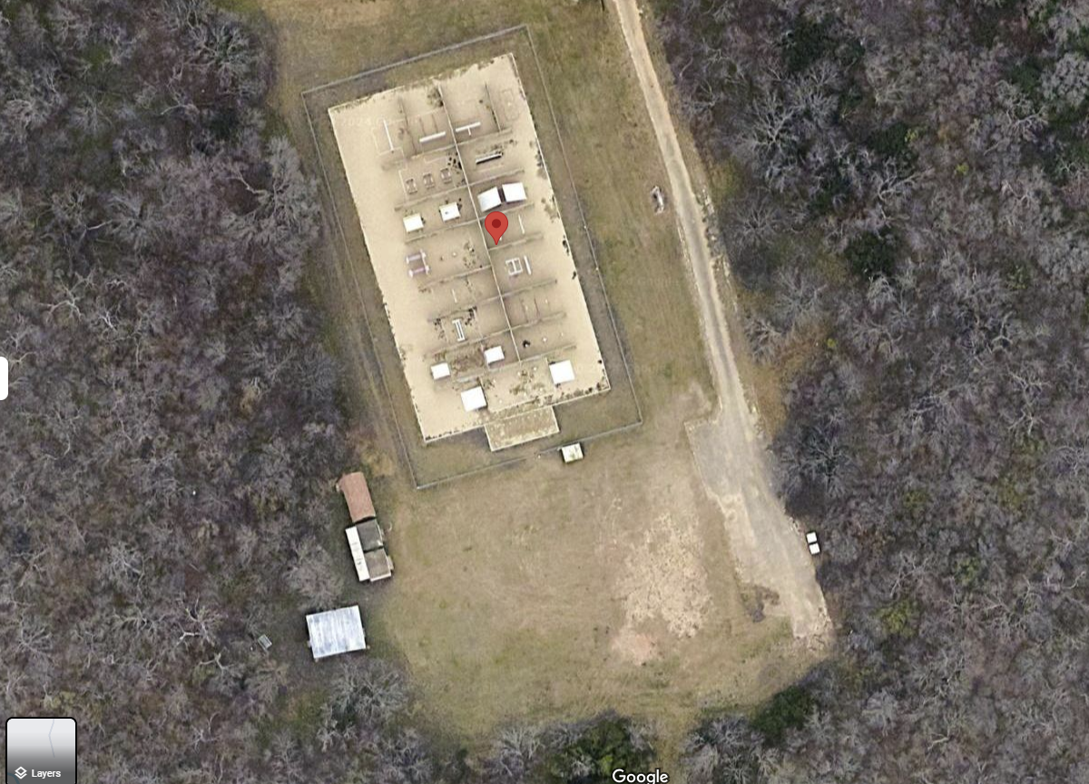
Locations
Cadet will park in the Red Outlined Area from Back to Front.
Cadets will form up to the side of the obstacle course, facing away from the obstacle course
Cadets will be split into groups and guided inside obstacle courses
LRC Courses
Air Force ROTC Detachment 842 • We Build Exceptional Officers • The University of Texas at San Antonio

Slide 13
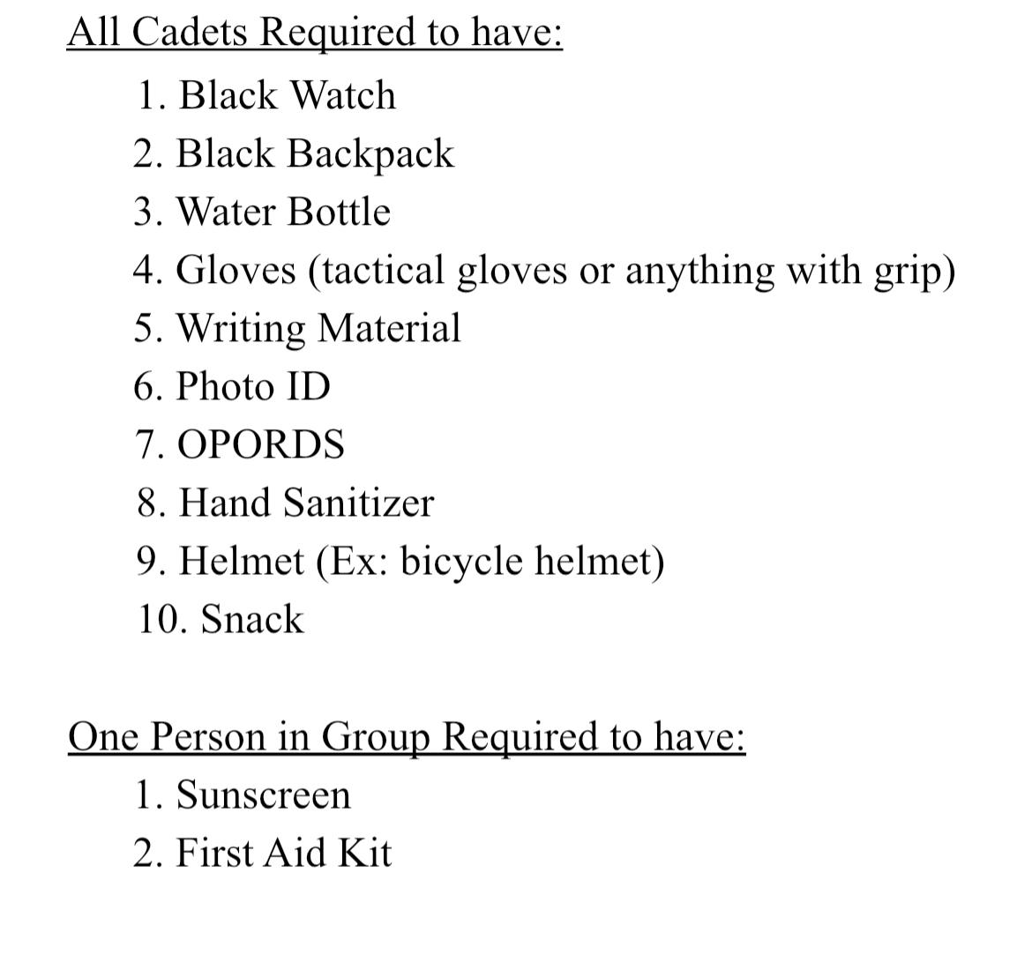
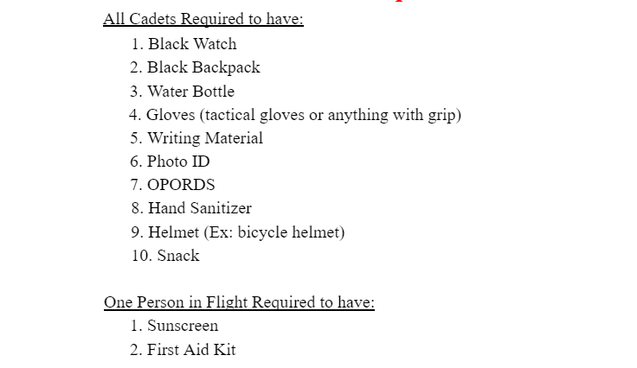
Required Items
Required items will be checked prior to transitioning to Camp Bullis
Air Force ROTC Detachment 842 • We Build Exceptional Officers • The University of Texas at San Antonio

Slide 14
UOD
Flights must be standardized
IMT/FTP
Det Shirt
Blue Jeans
Black Belt
Tennis Shoes
Black Watch
Black Jacket
Air Force ROTC Detachment 842 • We Build Exceptional Officers • The University of Texas at San Antonio

Slide 15
Safety/Execution
Obstacle courses are not playgrounds
Hydration
Helmets will be worn at all times
No Jewelry is permitted
Gloves will be worn at all times
Challenge yourself
Prepare to lead an LRC
Air Force ROTC Detachment 842 • We Build Exceptional Officers • The University of Texas at San Antonio

Slide 16
Summary
LRC Definition
Timeline
Location
Required items
UOD
Safety/Execution
Air Force ROTC Detachment 842 • We Build Exceptional Officers • The University of Texas at San Antonio

Slide 17
Questions?

Slide 18
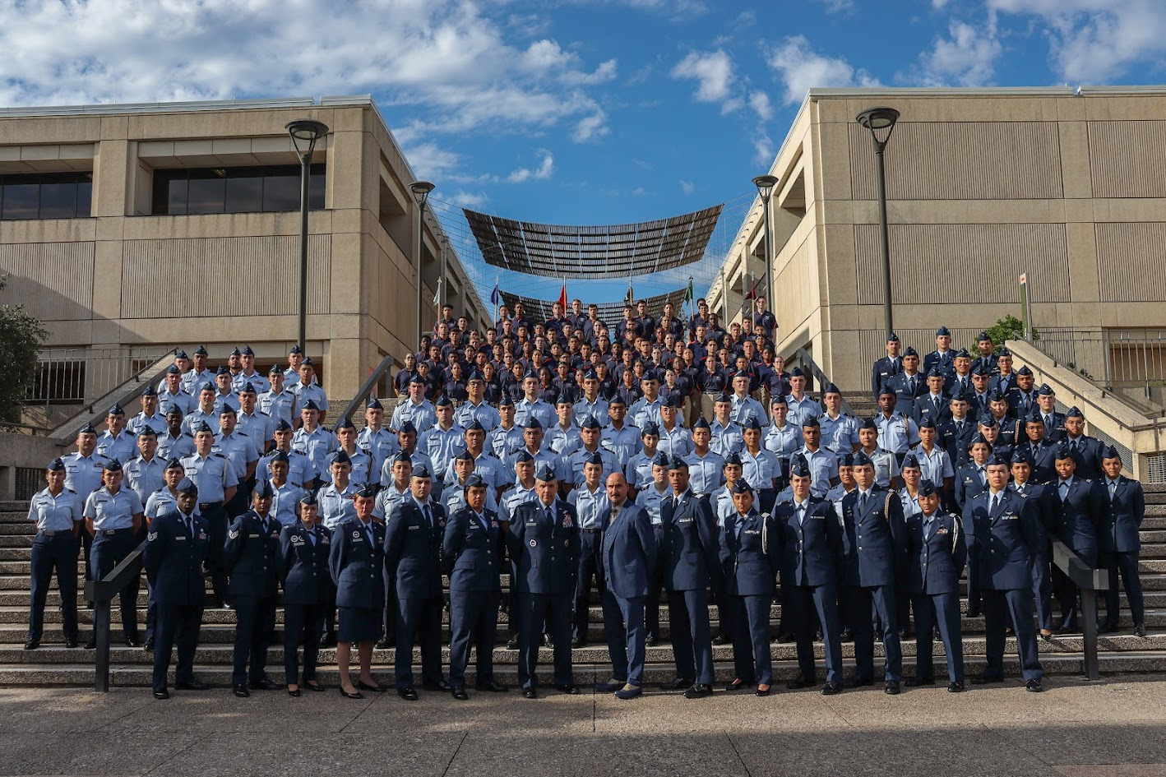
Air Force ROTC Detachment 842
The University of Texas at San Antonio
Det 842 – Best in Blue

